Slide 1
Configuration Management -Ansible

Slide 2
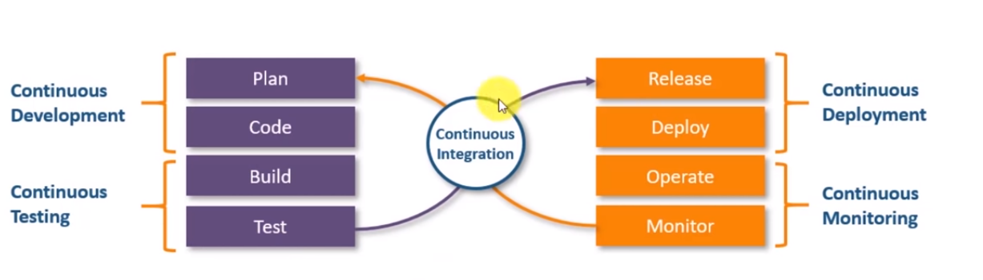
DevOps Introduction

Slide 3
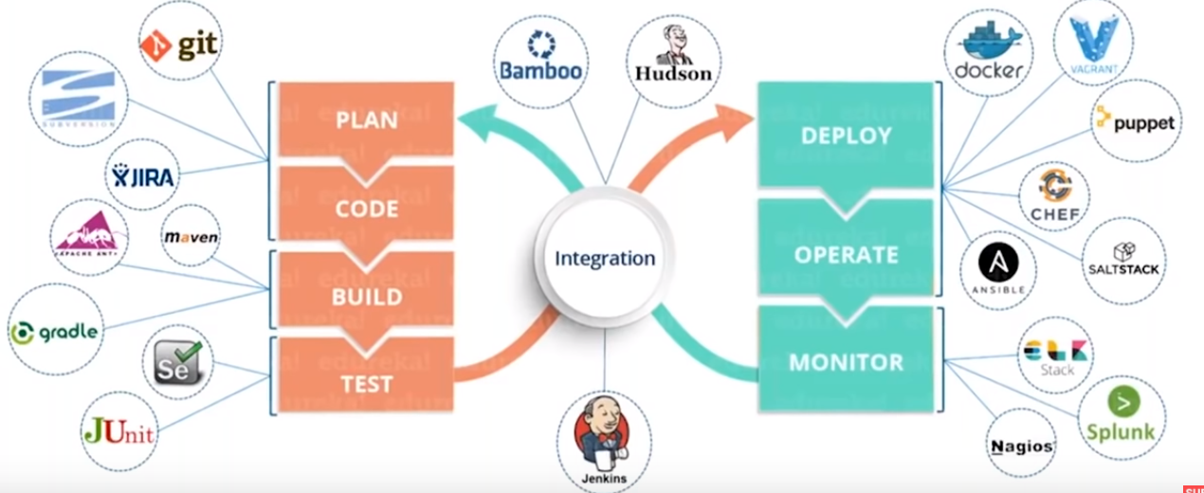
Devops

Slide 4
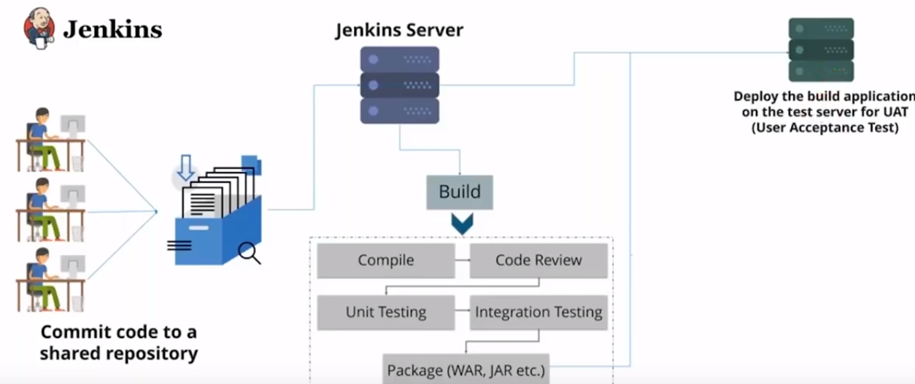
Continuous Delivery

Slide 5
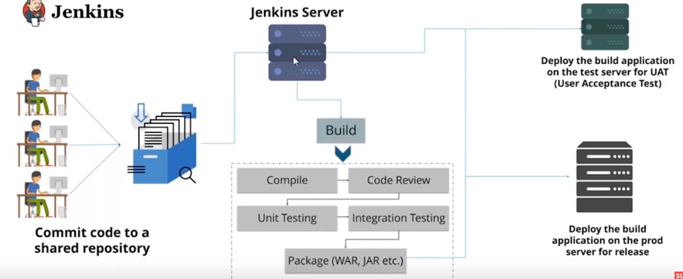
Continuous Deployment

Slide 6
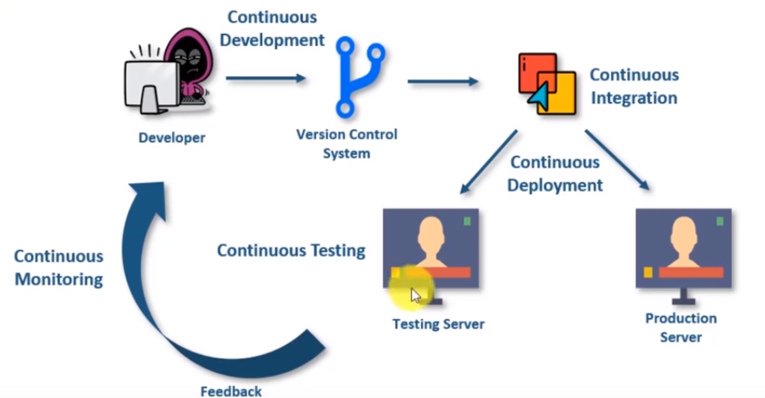
How Devops Works

Slide 7
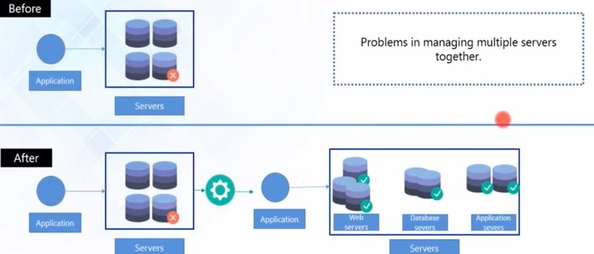
Why Configuration Management ?

Slide 8
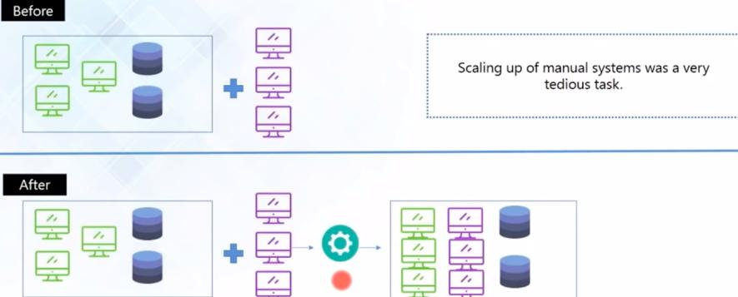
Why Configuration Management ?

Slide 9
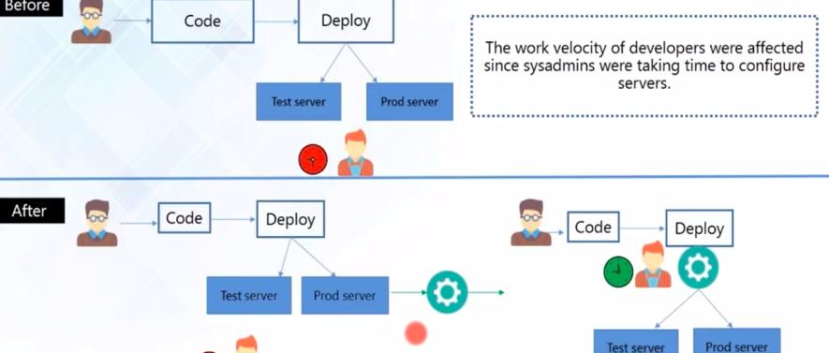
Why Configuration Management ?

Slide 10
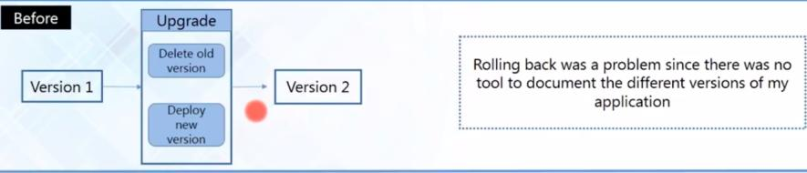
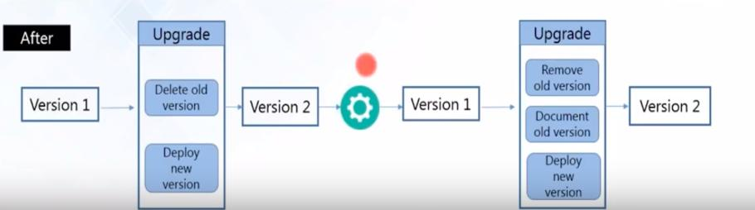
Why Configuration Management ?

Slide 11
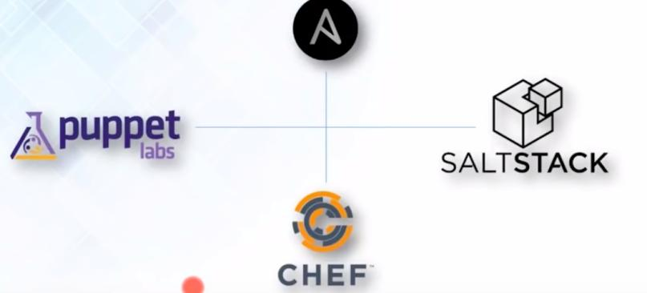
Configuration Management Tools

Slide 12
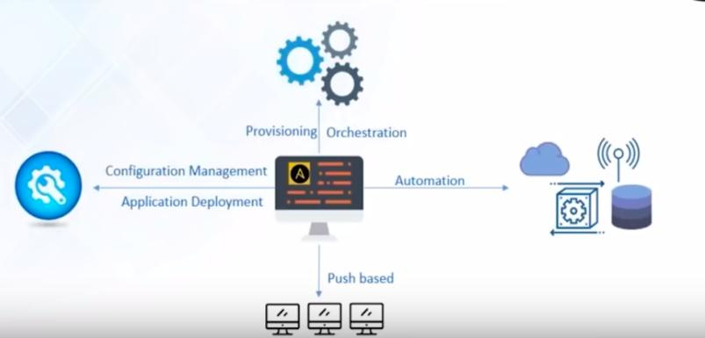
Ansible Features

Slide 13
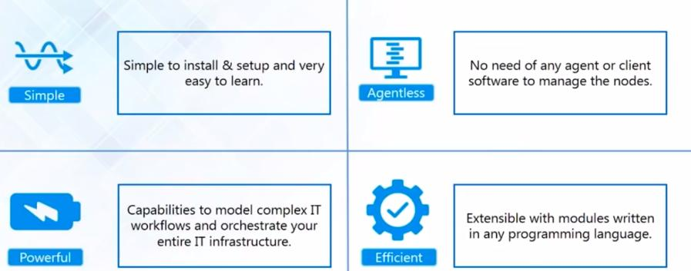
Ansible Features

Slide 14
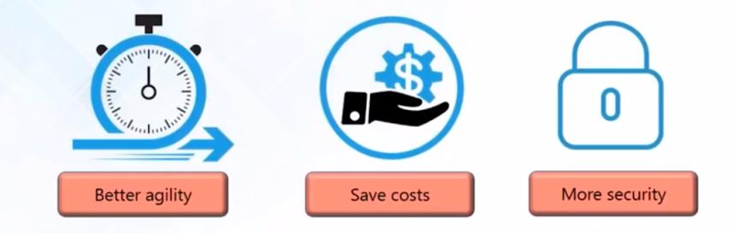
Case Study of NASA

Slide 15
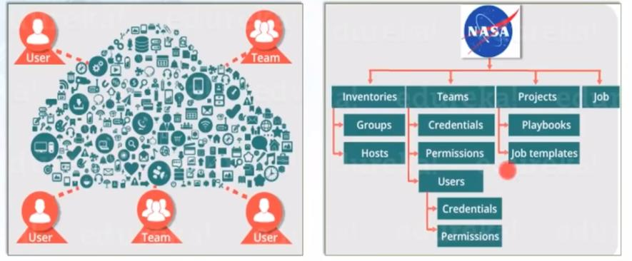
Case Study of NASA

Slide 16
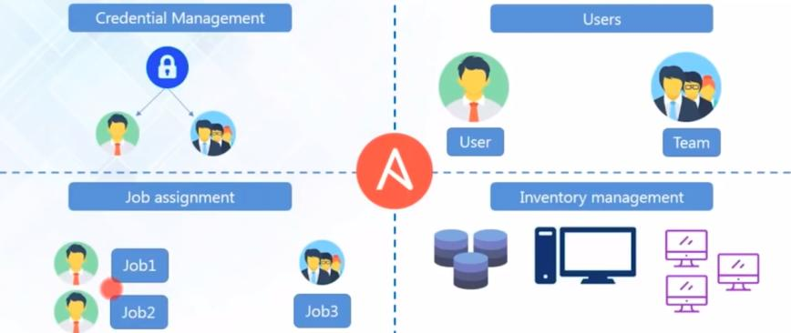
Case Study of NASA

Slide 17
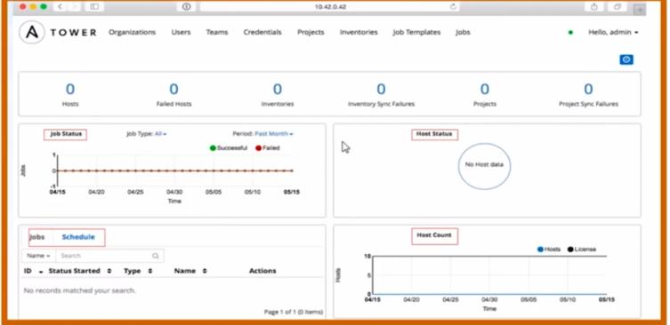
Ansible Tower Dash Board

Slide 18
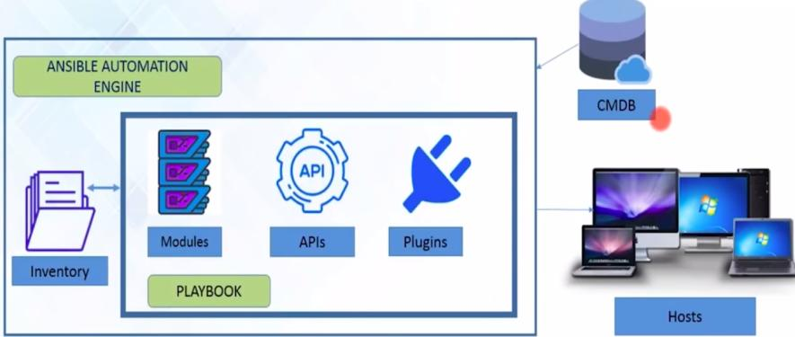
Ansible Architecture

Slide 19
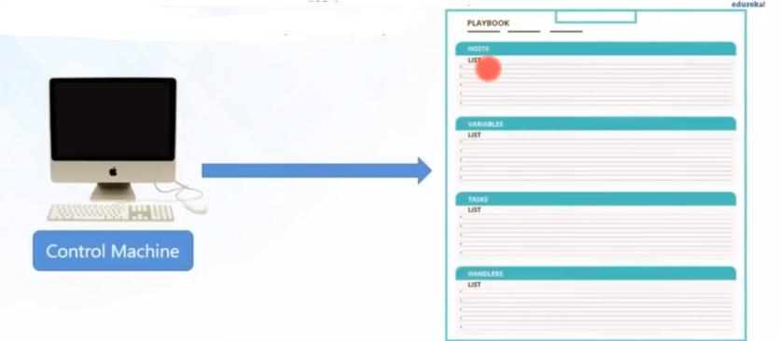
Ansible Playbook

Slide 20
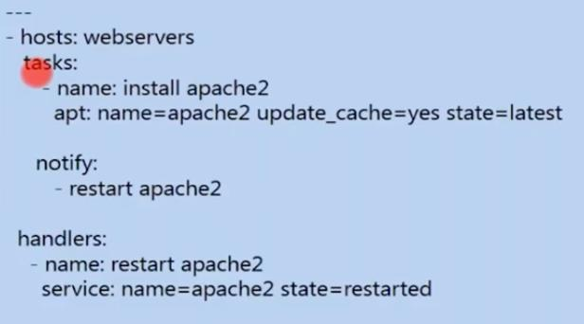
Playbook Example

Slide 21
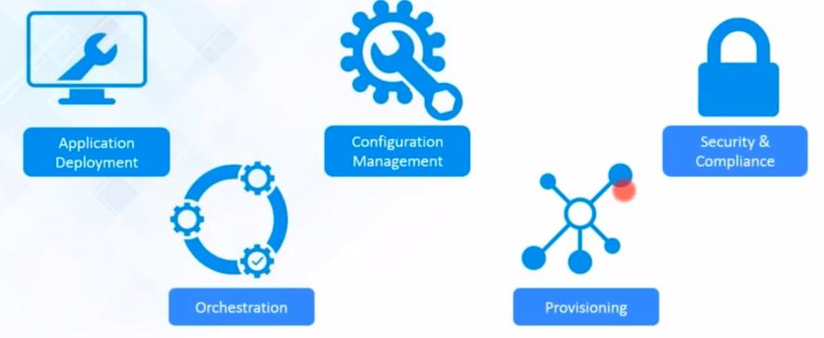
Ansible operations(Functions)

Slide 22
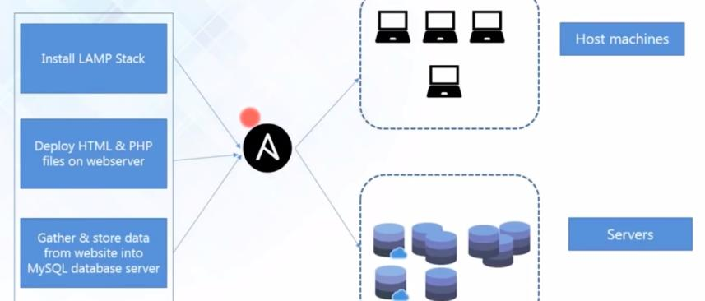
Ansible - Orchestration

Slide 23
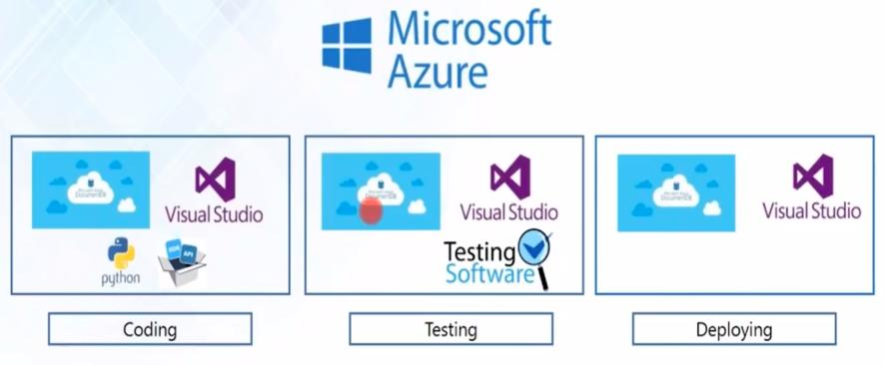
Ansible - Provision

Slide 24
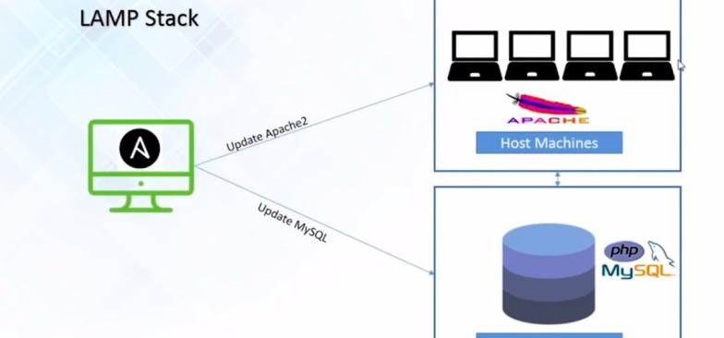
Ansible – Configuration Managment

Slide 25
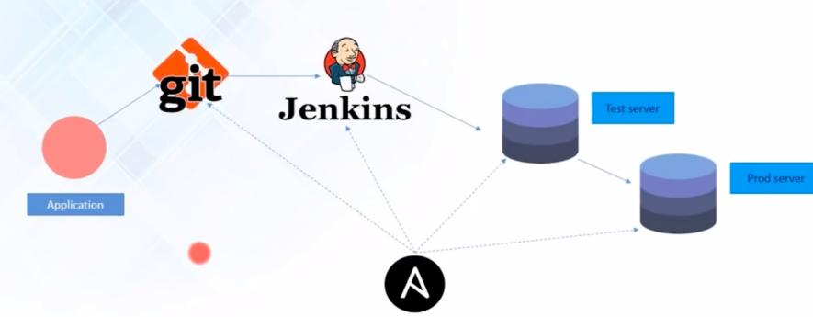
Ansible – Application Deployment

Slide 26
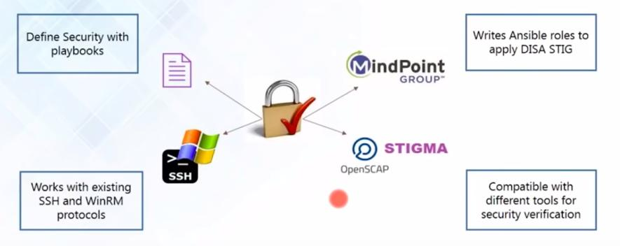
Ansible - Security

